Slide 1
Correct Posture Electronic (CPE)
Rodrigo Valdivia & Rayed Khan

Slide 2
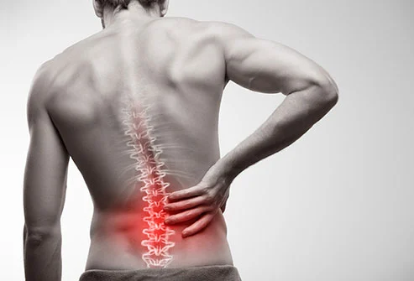

Lower back pain
Lifetime prevalence - 60% to 70%
Leading cause of worldwide productivity loss.
Higher prevalence - 35-55yrs.
Notes:
A study done in 195 countries assessing the incidence, prevalence, and years lived with disability for 354 medical conditions found low back pain to be the leading cause of worldwide productivity loss as measured in years, and the top cause of years lived with disability in 126 countries.
3 Prevalence increases and peaks between the ages of 35 and 55. It is increasing in teenagers.
It is exacerbated by sedentary lifestyles, the workplace, low educational status, stress, anxiety, depression, job dissatisfaction and low levels of social support in the workplace

Slide 3
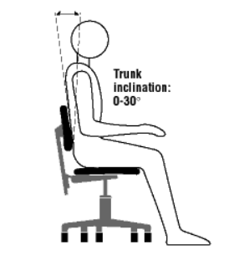
Sitting Posture
Evidence that addressing sitting posture reduces lower back pain. (Dankaerts et al., 2009)
Ideal sitting angle
Body within 30° of trunk inclination (Canadian Centre for Occupational Health and Safety).
Notes:
There is not a specific consensus for ideal sitting angle, but researches generally suggest that 20-30 degrees backwards reduces the strain in the muscles, and that forwards inclination leads to lower back pain.

Slide 4
Objective

Slide 5
*demo*

Slide 6
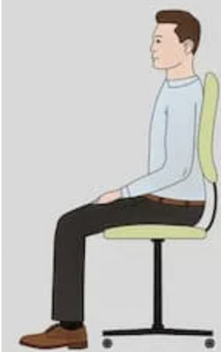
90
0
180
(side view)
Notes:
Talk about existence of “roll” within the IMU sensor inside the M5Stack device and how it can be used to monitor posture in a standard sitting position. Talk about existence of an acceptable range. (100-110 ideal)

Slide 7
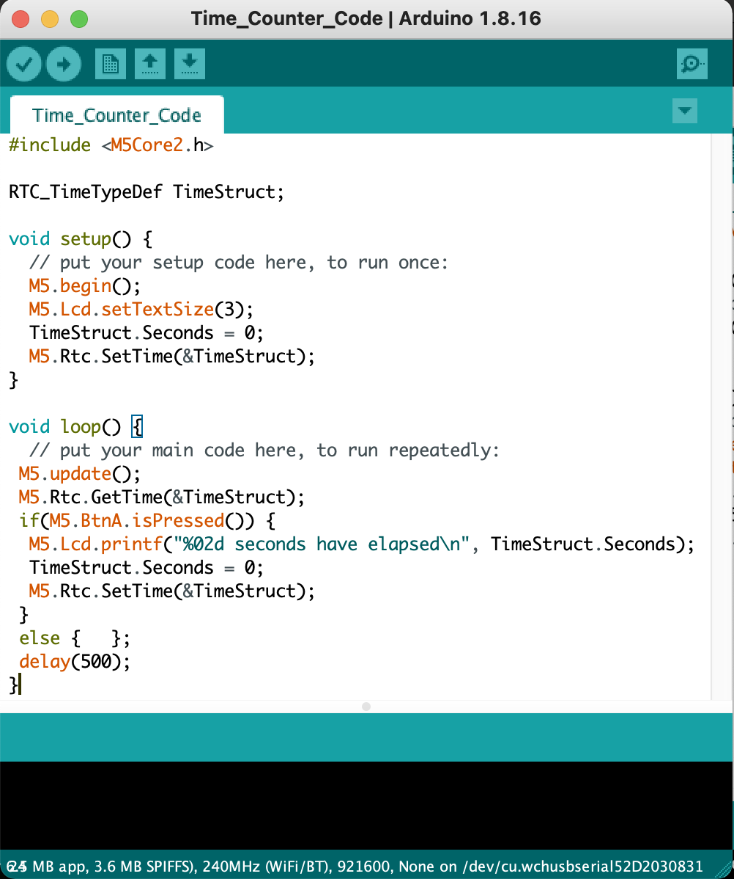
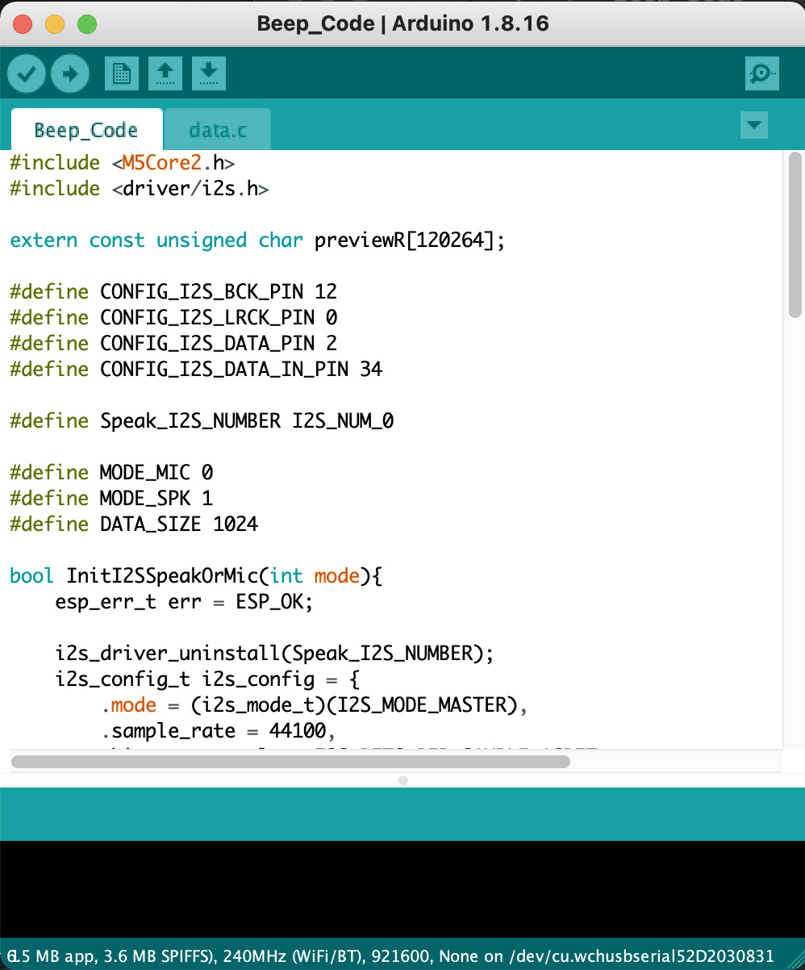
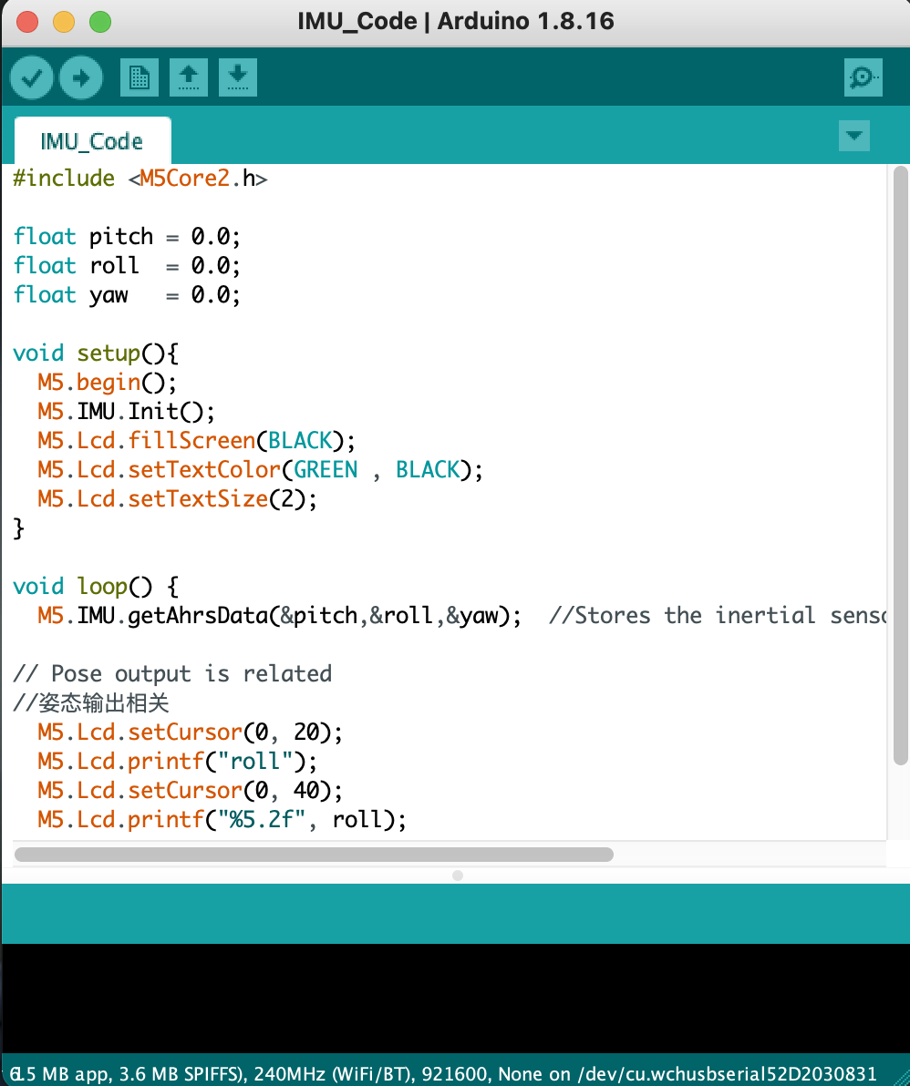
Notes:
Talk about extraction of required code from default examples within Arduino and consequent testing to correspond to individual features within program

Slide 8
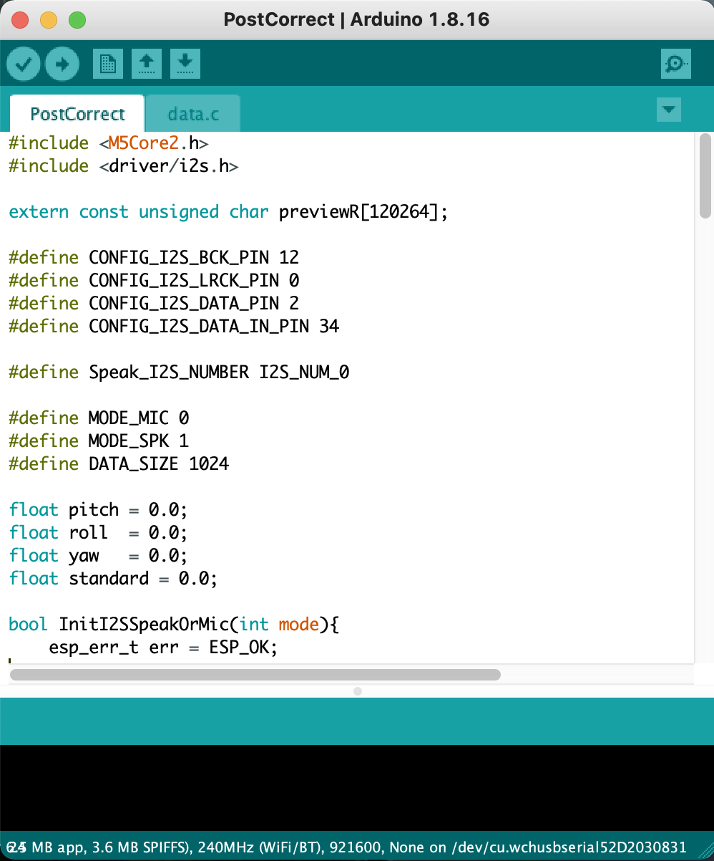
Notes:
Talk about various individual features (and thus, projects) being brought together to form a single project. Different features being called based on certain conditions being satisfied.

Slide 9
Check roll value
If within range,
If outside range,
Green display
Red display
Check time since red,
When equal to 5 seconds (continuously,) beep & vibrate

Slide 10

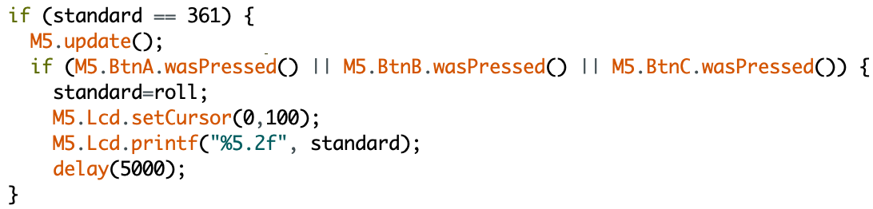

Slide 11
Limitations and future implementations

Slide 12
Bibliography
Hoy, D, Brooks, P, Plinth, F, Buchbinder, R. (2010). The Epidemiology of low back pain. Best Practice & Research Clinical Rheumatology. Volume 24, Issue 6, 769-781. https://doi.org/10.1016/j.berh.2010.10.002.
E. Grandjean, W. Hünting. (1977). Ergonomics of posture—Review of various problems of standing and sitting posture. Applied Ergonomics.8(3).135-140.https://doi.org/10.1016/0003-6870(77)90002-3.
W. Dankaerts, P. O'Sullivan, A. Burnett, L. Straker, P. Davey, R. Gupta. (2009)Discriminating healthy controls and two clinical subgroups of nonspecific chronic low back pain patients using trunk muscle activation and lumbosacral kinematics of postures and movements: a statistical classification model. Spine, 34 (15) , pp. 1610-1618
Canadian Centre for Occupational Health and Safety. (2010). Working in a Sitting Position - Good Body Position. https://www.ccohs.ca/oshanswers/ergonomics/sitting/sitting_position.html

